Slide 1
B351 Final Project: Important or not
Team members:
Tian Jin, Yitian Zhang, Bokai Zhuang

Slide 2
HOW TO PLAY THIS GAME?
Game introduction:
This is a card game between two players who hold two groups of cards respectively, and which can be divided into even group [2,4,6,8] and odd group [1,3,5,7,9].

Slide 3
HOW TO WIN THIS GAME?
Game rule:
For each round, each player will draw a card in rotation while telling the opponent which group the card he drew is from. And they will keep doing that until all the cards are gone. When this is happening, there is a third party as referee to compare the cards the players draw each round, the bigger card wins for that round, accordingly, the winner for that round will earn one point. Of course, there might be tie, so every player earns one point under this circumstance. The final winner will be up to how many points they have earned in the end.

Slide 4
WHAT WE HAVE DONE FOR AI TO WIN?
We have created an algorithm by our own, which is
score = sensibility * wining rate
Sensibility: sensibility is how much information a card can fetch. For example, the card “5” has more sensibility than other cards. If you know opponent drew a card from odd group, and you lost with 5, then the information you know is the card opponent drew could be 7 or 9. If won with 5, then the cards could be 1or 3. Therefore we say 5 have more sensibility.
Winning rate: the possibility to beat opponent with the card you drew. Such as winning rate for 5 here is 2/5 if opponent draws a card from even group.
Score: score is the product of the winning rate and sensibility. The decision machine makes to decide which card should be drew is up to the scores. The highest score has the priority to be drawn first.

Slide 5
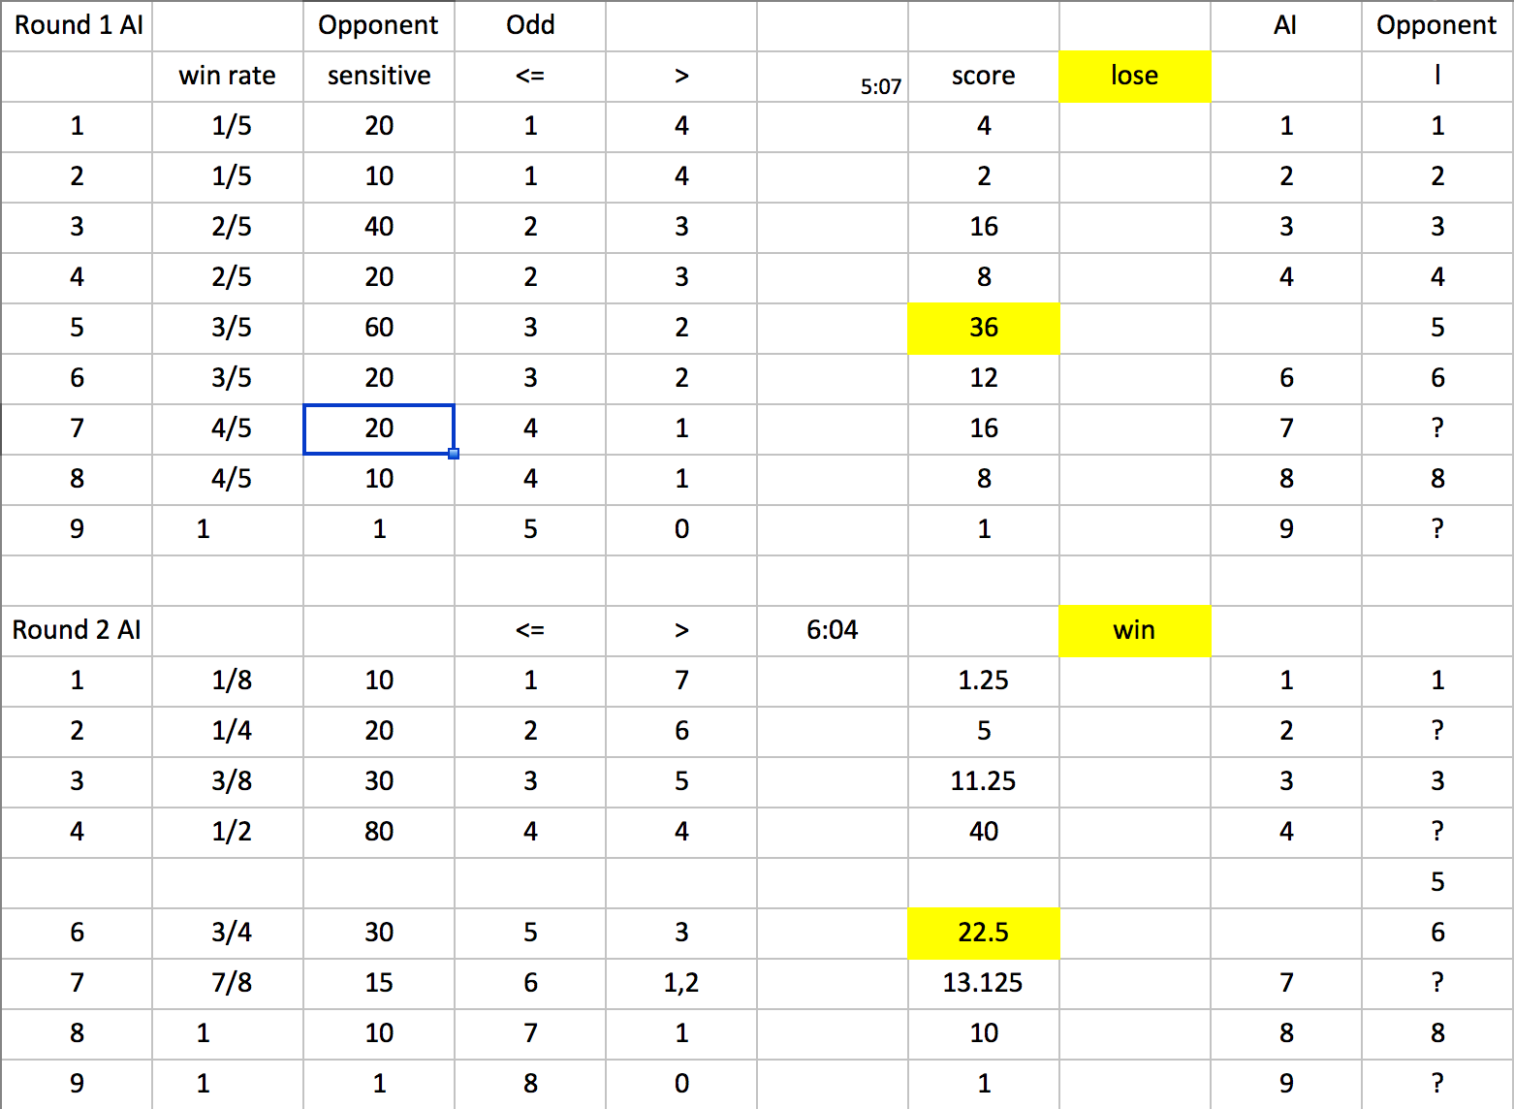
SUCH AS (for first two rounds) :

Slide 6
WHAT WE HAVE DONE FOR AI TO WIN?
2. Searching method: BFS searching
Since we can use BFS tree to store the information that what cards the opponent has left so that we can predict what cards the opponent might draw in the next few rounds.

Slide 7
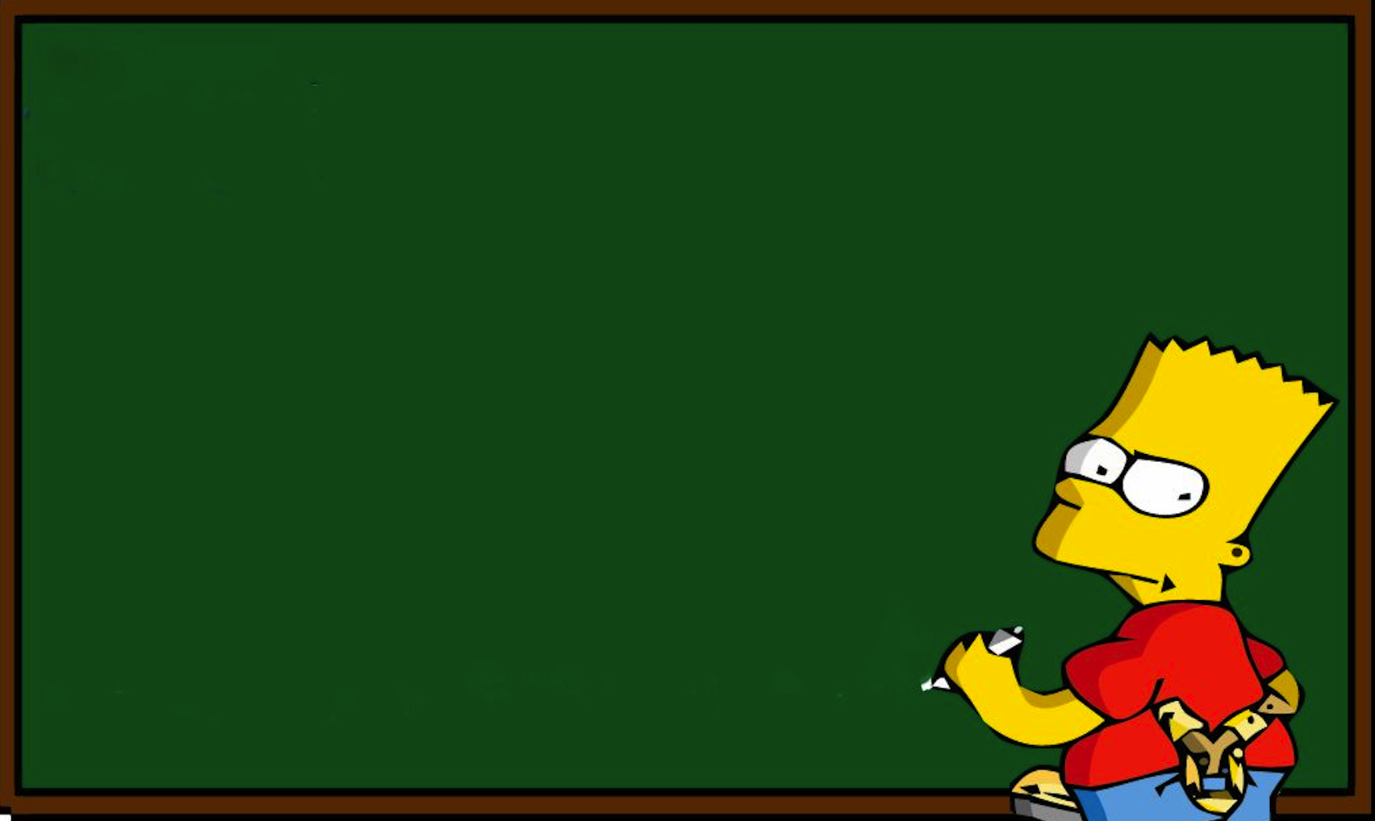
SUCH AS:
/
EXAMPLE ON THE BLACKBOARD

Slide 8
ROOM TO IMPROVE
The current probability the AI wins is around 65% when we run 1000 times. If we want to increase the number to over 80%, we should train the AI to be capable of being more strategic. For example, using a small card to trick opponent so that the opponent would choose a big cards such as 8 or 9 to beat over 1 or 2.

